Slide 1





Inference of demographic histories and distributions of fitness effects of deleterious mutations from human gut microbiomes
Jonathan Mah
Lohmueller and Garud Labs
September 26th, 2023
@jonmah_compbio
jonmah@g.ucla.edu
Notes:
How’s it going guys, gals, and non-binary pals, my name is Jonathan Mah, I’m a PhD student coadvised by Professor Kirk Lohmueller and Professor Nandita Garud, and time permitted, today I’ll be talking about my #soon to be submitted work concerning inference of demography and selection in the human gut microbiome. But before we begin, I’d like to start off with a quick story about... I know we’re all thinking it… That’s right, you guessed it… →

Slide 2
The US National Census
Notes:
The US National Census.
Here is how this works.
Every 10 years →

Slide 3

The US National Census
Notes:
The government sends a bunch of people with clipboards to ask questions, such as how many people are living, what kind of people are they, and where do they live.

Slide 4

The US National Census
Notes:
This information is used to distribute voting power in the House of Representatives, so to some extent it does have fairly meaningful consequences.

Slide 5
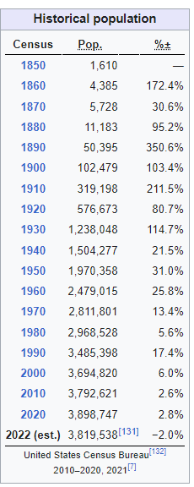
How do population sizes change over time?
Expansion
Notes:
One of the things that the census tracks is how population sizes change over time. As an example, from the census, we can see that as of the year 2000, Los Angeles had a population of about 3.7 million people, increasing to 3.8 and then 3.9 million in the following decades.

Slide 6
How do population sizes change over time?
Expansion
Why?
Notes:
If you’re like me, and politics fills you with dread, then you might want to know why.

Slide 7
How do population sizes change over time?
Expansion
Why?
Beautiful weather
Great food
The Dodgers
Notes:
There are plenty of reasons why more people want to live in Los Angeles: We have beautiful weather, we have great food, and the Dodgers even won the world series in 2020.

Slide 8
How do population sizes change over time?
Expansion
Contraction
Why?
Beautiful weather
Great food
The Dodgers
Notes:
However, the census also lets us know that, relative to 2020, Los Angeles has instead seen a decrease in estimated population size, as of 2022.

Slide 9
How do population sizes change over time?
Expansion
Contraction
Why?
Why?
Beautiful weather
Great food
The Dodgers
Notes:
If you’re like me and politics fills you with dread, then you might want to know why.

Slide 10

How do population sizes change over time?
Expansion
Contraction
Why?
Why?
Beautiful weather
Great food
The Dodgers
COVID-19
Cost of Living
The Angels except for Shohei Ohtani and Mike Trout
ohtani please join the mariners
Notes:
There are plenty of reasons why there are fewer people living in Los Angeles: Covid-19, the high cost of living, and our other baseball team, The Angels.

Slide 11

We gain insight into demographic trends over time
How many people live in Los Angeles?
Notes:
Altogether, the Census gives us important insights into demographic trends, which have real, tangible effects on our lives.
What I do, is very similar, except instead of asking “How many people live in Los Angeles”, I ask

Slide 12

We gain insight into demographic trends over time
How many people live in Los Angeles?
How many bacteria live in people?
Notes:
What kind of bacteria, and how many, live in people?

Slide 13
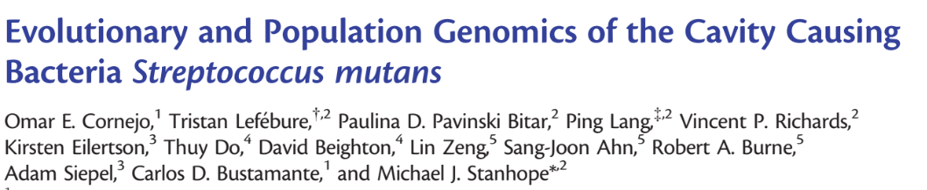
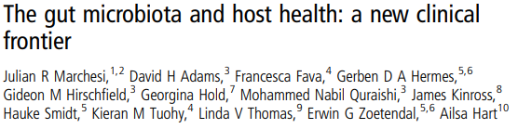
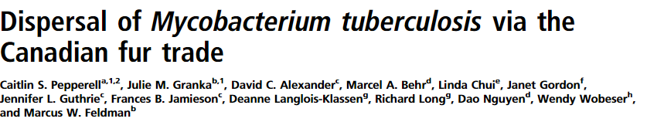
We gain insight into demographic trends over time
How many people live in Los Angeles?
How many bacteria live in people?
Notes:
If you’re like me, and bacteria fills you with bacteria, then you might want to know why.

Slide 14
We study the Human Gut Microbiome
Notes:
Our system of study is the bacteria that live in, on, and around us, otherwise known as the Microbiome. In particular, I study the bacteria present in our guts

Slide 15
We study the Human Gut Microbiome
Ruminococcus bromii
Notes:
Here is a simple cartoon schematic of a person and their bacteria, with these lines on the right-hand side representative of bacterial genomes. We ask fundamental basic science questions about evolution and ecology in the human gut microbiome across human populations and so towards this end our data consists of one strain per species per host
Make
Remove the star
Talk Number of strains per host and that they are genetically distinct
Explain lines as graphical representation for genomes

Slide 16
We study the Human Gut Microbiome
Ruminococcus bromii
Typically, 1-4 strains per species per host
Notes:
Here is a simple cartoon schematic of a person and their bacteria, with these lines on the right-hand side representative of bacterial genomes. We ask fundamental basic science questions about evolution and ecology in the human gut microbiome across human populations and so towards this end our data consists of one strain per species per host
Make
Remove the star
Talk Number of strains per host and that they are genetically distinct
Explain lines as graphical representation for genomes

Slide 17
How do demographic metrics, such as nucleotide diversity, differ by geography?
Notes:
Like the Census, we began our investigation by asking how nucleotide diversity might differ by geography

Slide 18
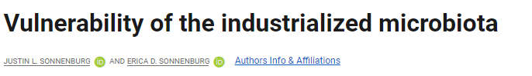
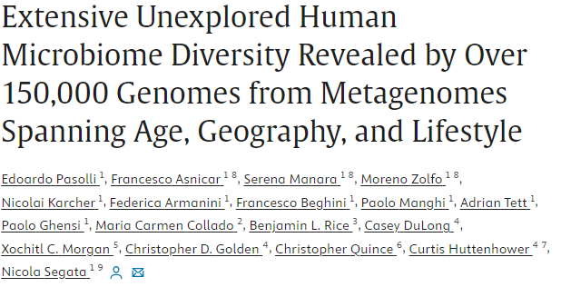
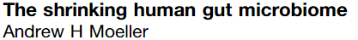
How do demographic metrics, such as nucleotide diversity, differ by geography?
Notes:
There is a fairly substantial body of work suggesting that the microbiomes of people living in urbanized, industrialized, westernized societies (that’s everyone here) have seen general reductions in microbiome diversity at the level species, gene, and nucleotide diversity

Slide 19

How do demographic metrics, such as nucleotide diversity, differ by geography?
Notes:
This is important in the context of human health because such depletions in diversity are associated with certain negative or deleterious health outcomes, such as increased susceptibility to infectious, developmental, and chronic diseases

Slide 20
We compute nucleotide diversity
Notes:
We used fecal shotgun metagenomic sequencing data to investigate population genetics questions in the human gut microbiome.
More informally, instead of “population genetics”, we like to call this work “Poopulation genetics”

Slide 21
We compute nucleotide diversity
Within hosts
Between hosts
Notes:
We computed the nucleotide diversity both within hosts and between hosts for several bacterial species present in
Provide some further context on why depleted nucleotide diversity is unhealthy / correlated with negative health outcomes
Think of a different way of illustrating this

Slide 22
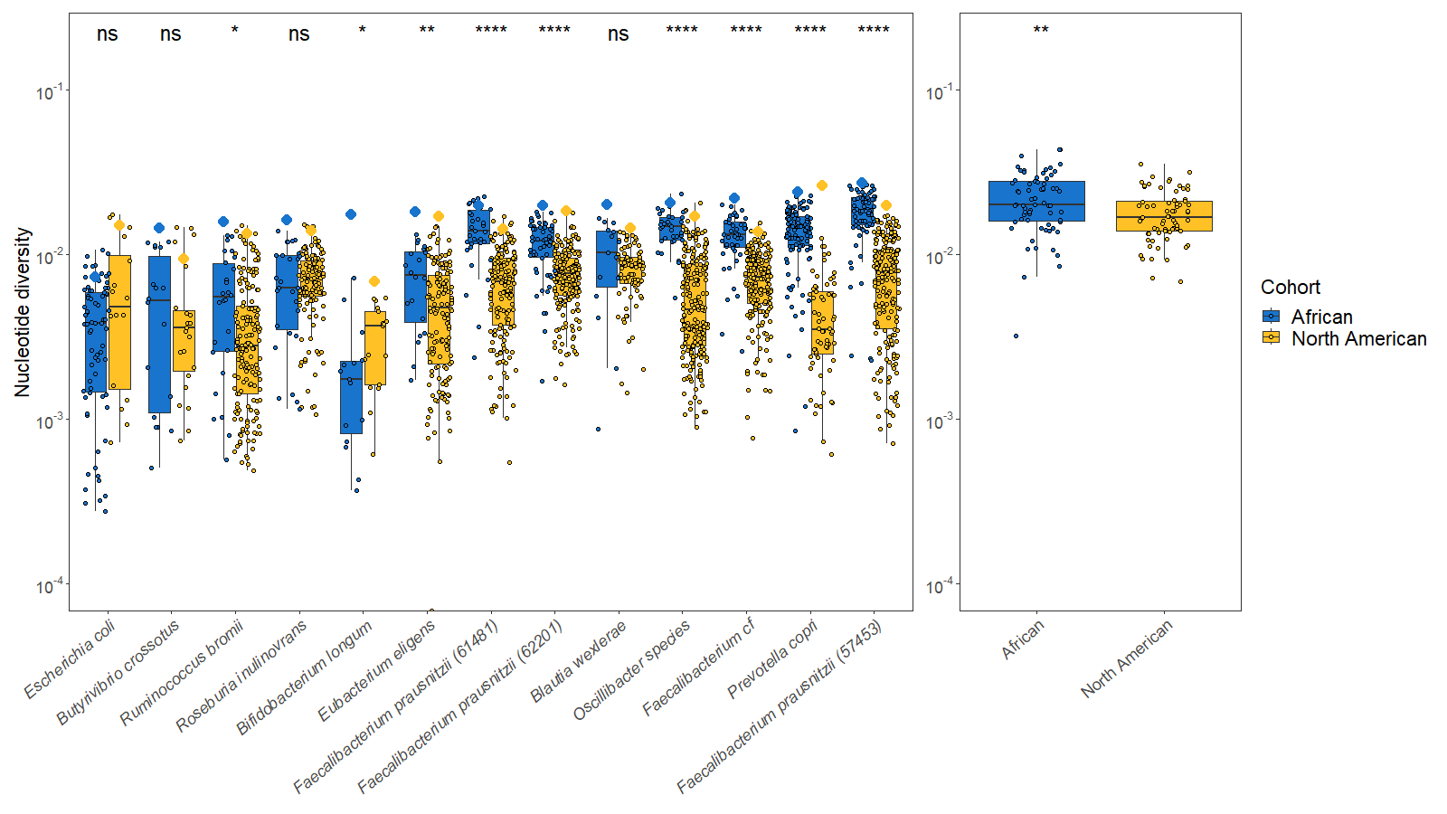
How do demographic metrics, such as nucleotide diversity, differ by geography?
A
B

Slide 23
How do demographic metrics, such as nucleotide diversity, differ by geography?
A
B

Slide 24
How do demographic metrics, such as nucleotide diversity, differ by geography?
A
B

Slide 25
How do demographic metrics, such as nucleotide diversity, differ by geography?
A
B

Slide 26
How many bacteria live in people?
Notes:
Next we turned our attention to investigating how many bacteria live in people. Given our findings of depleted nucleotide diversity, focused the remainder of our analysis on North American gut microbiomes

Slide 27
How many bacteria live in people?
One strain per species
per host
Notes:
Next we turned our attention to investigating how many bacteria live in people. Given our findings of depleted nucleotide diversity, focused the remainder of our analysis on North American gut microbiomes

Slide 28
We compute the site-frequency-spectrum
One strain per species
per host
30.00%
22.50%
Proportion of variants
15.00%
7.50%
0.00%
1 2 3 4
5
6
7
8
Mutation class (Singletons, doubletons, tripletons, etc.)
Notes:
To do so, we leverage a summary statistic of genetic variation known as the site frequency spectrum, which we can visualize here as a histogram by which the x-axis tells us how rare or common a mutation is and the y-axis denotes the proportion of mutations which fall into each level of rarity
Here, the 1st bar refers to singletons, which are mutations which only manifest once in a population
More properly convey how SFS is created, showing one strain per host

Slide 29
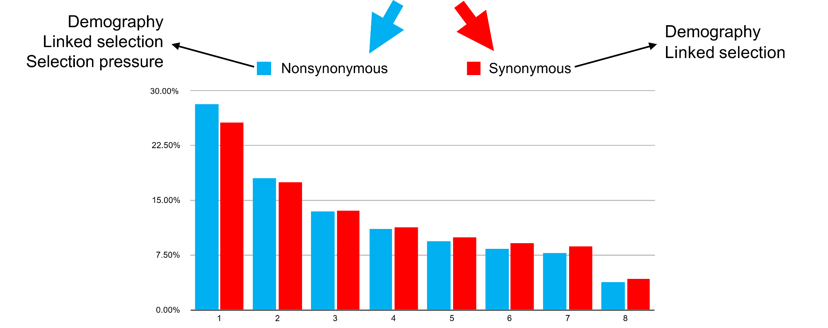
We split the site-frequency-spectrum into synonymous and nonsynonymous variants
30.00%
22.50%
Proportion of variants
15.00%
7.50%
0.00%
1 2 3 4
5
6
7
8
Mutation class (Singletons, doubletons, tripletons, etc.)
Notes:
Further, we can split this purple, bipartisan, SFS into putatively neutral synonymous mutations (shown here in red), and assumed negatively selected nonsynonymous mutations (shown here in blue).
The SFS is known to be subject to three major classes of forces, being demography, linkage, and selection.

Slide 30
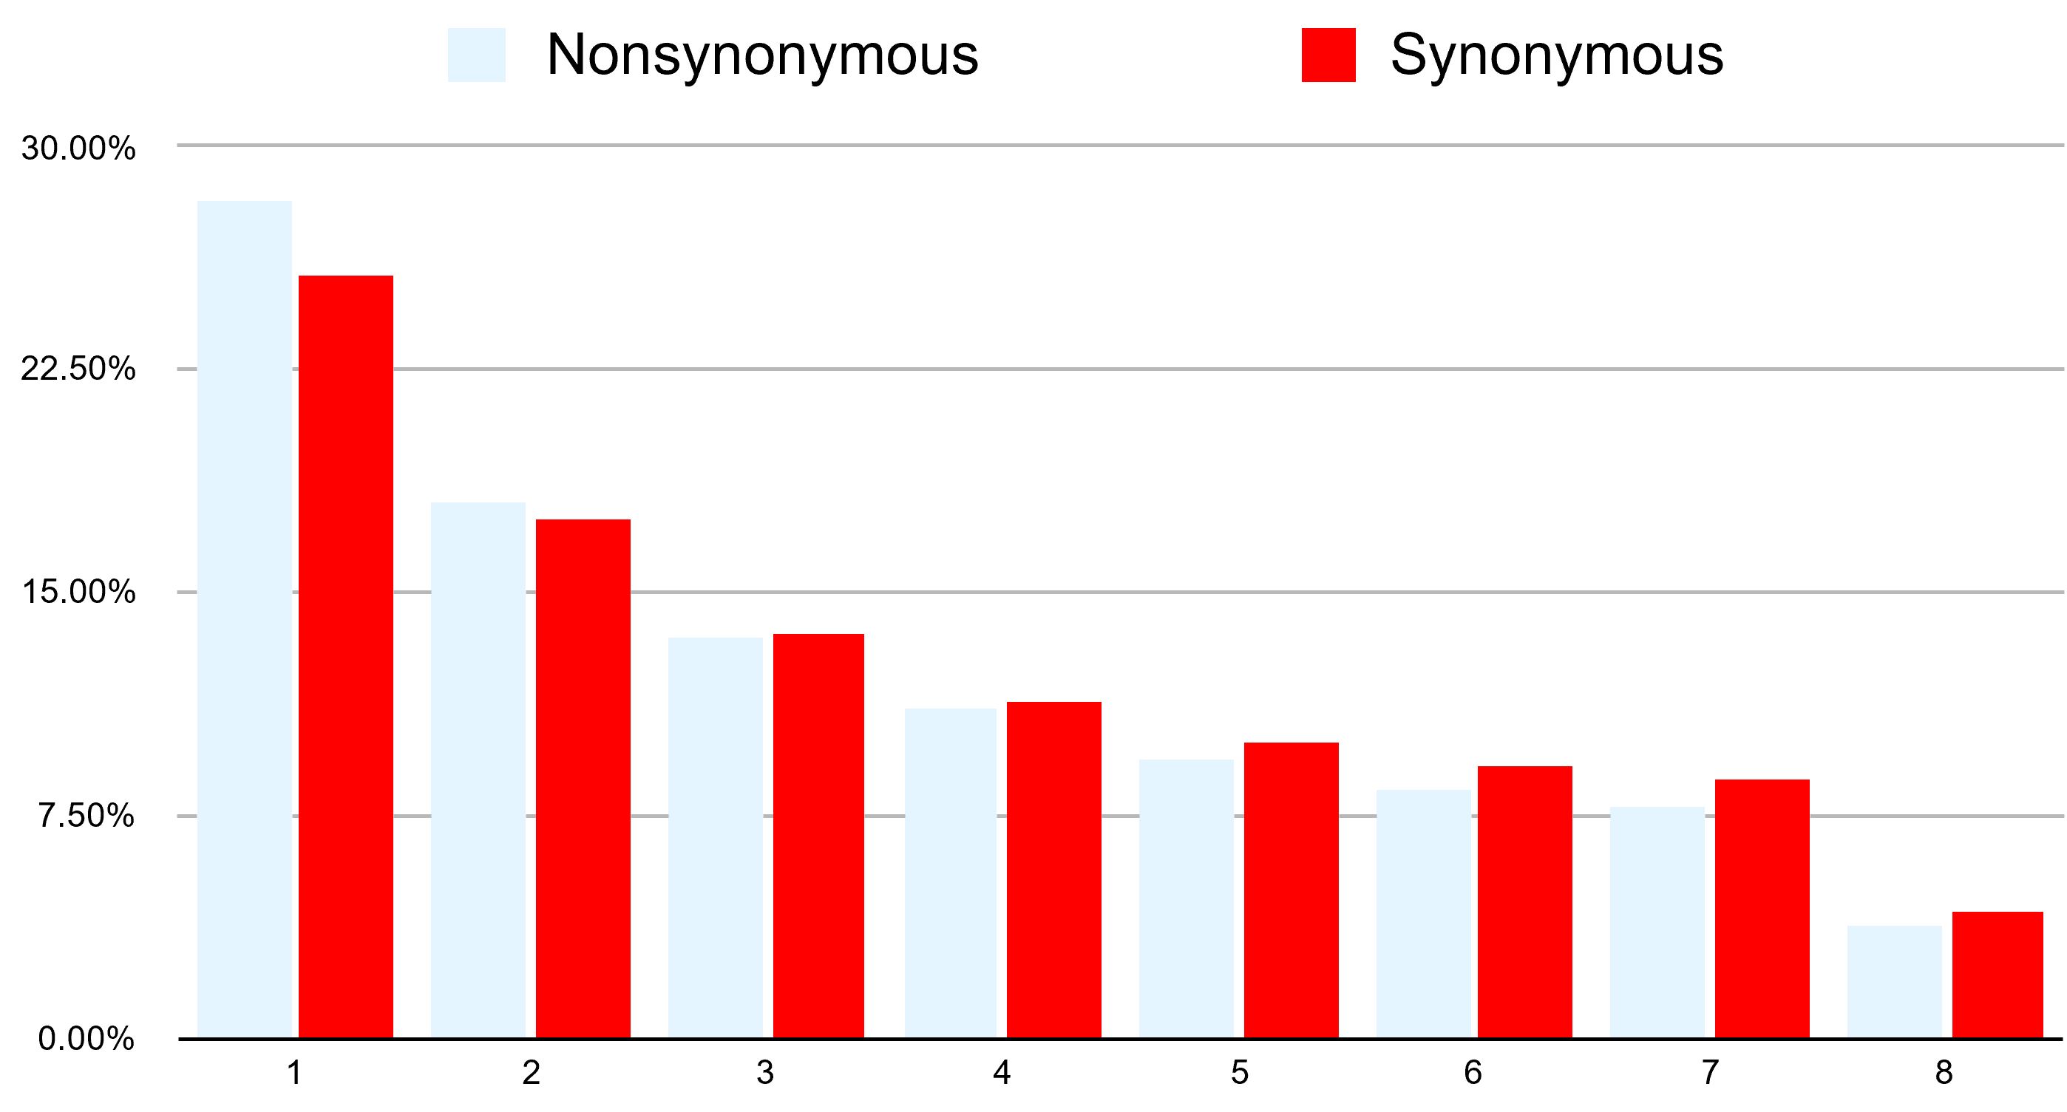
We use Dadi to infer demographic history
Demography
Linked Selection
Notes:
Note that, since we’re working with Bacteria, which have an extremely high rate of recombination, we can to some extent ignore linkage. Thus, our synonymous, red, SFS is almost entirely subject to the effects of Demography, which we can infer.

Slide 31
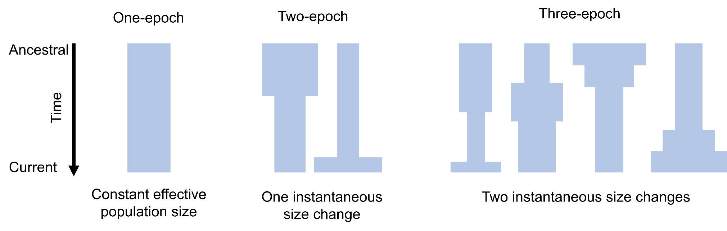
We use Dadi to infer demographic history
Demography
Linked Selection
Notes:
We use a statistical inference package known as Dadi to infer demographic models from the synonymous SFS. On the right here I show several different cartoon schematics for different model specifications. The width of each schematic corresponds to the effective population at the time.

Slide 32
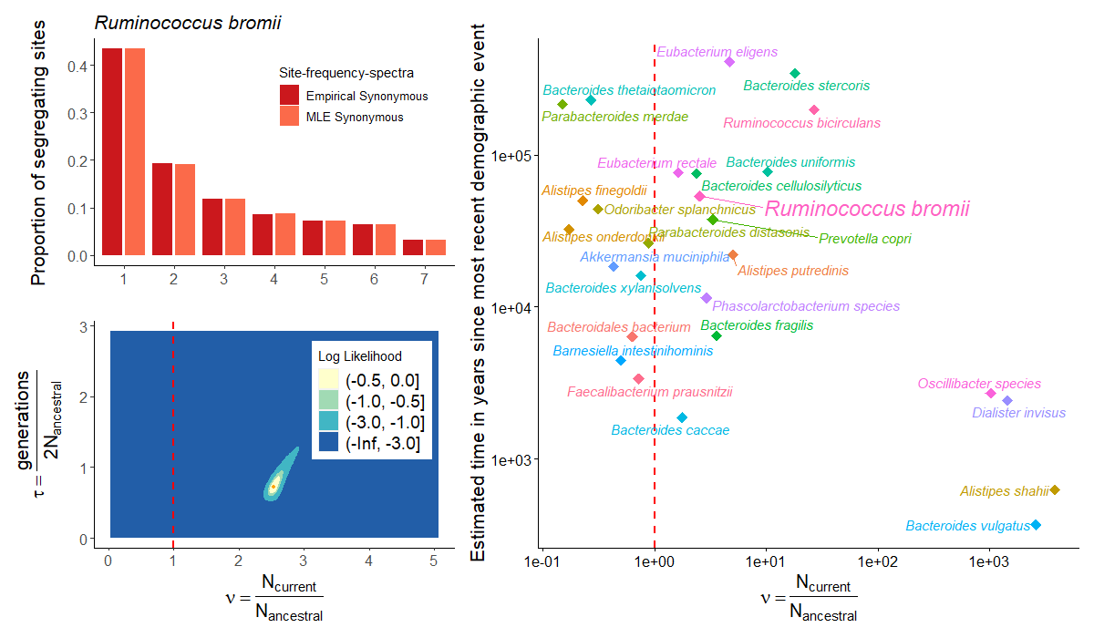
We infer varied demographic histories
Notes:
Let’s proceed by walking through a couple of examples. Here I show the synonymous site-frequency spectrum of a bacterial species, Ruminococcus bromii.
In darker colors we show the empirical data, while in lighter colors we show the spectrum simulated under our demographic model.

Slide 33
We infer varied demographic histories
Notes:
Speaking of, the way we fit these model is by exploring a 2-parameter likelihood surface using a gradient descent based approach. Our two parameters are “nu”, shown along the x-axis, which represents a ratio of current to ancestral population size,

Slide 34
We infer varied demographic histories
Notes:
And “tau”, shown on the y axis, representing the amount of time which passes in an epoch, in units of generations per 2 times the ancestral population size.

Slide 35
We infer varied demographic histories
Notes:
A difference of three log likelihoods approximates a 95% confidence interval.
In summary, the model parameters which simulate a model SFS most closely fitting the observed data is assumed to represent the underlying evolutionary history.

Slide 36

We infer varied demographic histories
Notes:
Want to see me do it again?

Slide 37
We infer varied demographic histories
Notes:
We did, for 27 bacterial species simultaneously across the human gut microbiome. Here I’m showing a summarizing scatterplot where the x-axis is identical to the likelihood surface, and the y-axis is converted to actual units of time in years.

Slide 38
We infer varied demographic histories
Contraction
Expansion
Notes:
I’ve added a dotted red line on both the likelihood surfaces and the scatterplot, which separates the parameter space between contractions, such as A. muciniphila, and expansions, such as R. bromii. We find that bacteria are inferred to have varied demographic histories.

Slide 39
We infer varied demographic histories
Notes:
I’d like to note that this time frame of around 10,000 years is quite meaningful within the context of human history.

Slide 40
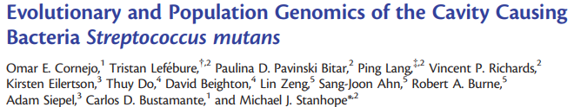
We infer varied demographic histories
Notes:
A similar study by Omar Cornejo et al. found a population demographic expansion in the cavity causing oral pathogen, Streptococcus mutans, on a time scale roughly coincident with the onset of human agriculture 10,000 to 20,000 years ago, in part due to increased ecological niche availability as a consequence of the shift in diet
Only have red SFS, larger orange dot – blue likelihood surface is ok given removal of nonsyn SFS
Set up the example of SFSs + likelihood surface using just R. bromii, with larger proportions for visibility
Add cartoon schematics to illustrate contraction vs. expansion

Slide 41
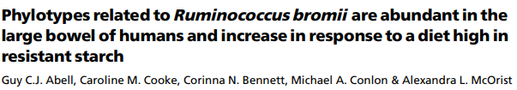
We infer varied demographic histories
Why?
Notes:
We did, for 27 bacterial species simultaneously across the human gut microbiome. Here I’m showing a summarizing scatterplot where the x-axis is identical to the likelihood surface, and the y-axis is converted to actual units of time.
I’ve added a dotted red line on both the likelihood surfaces and the scatterplot, which separates the parameter space between contractions, such as A. muciniphila, and expansions, such as R. bromii. We find that bacteria are inferred to have varied demographic histories.

Slide 42
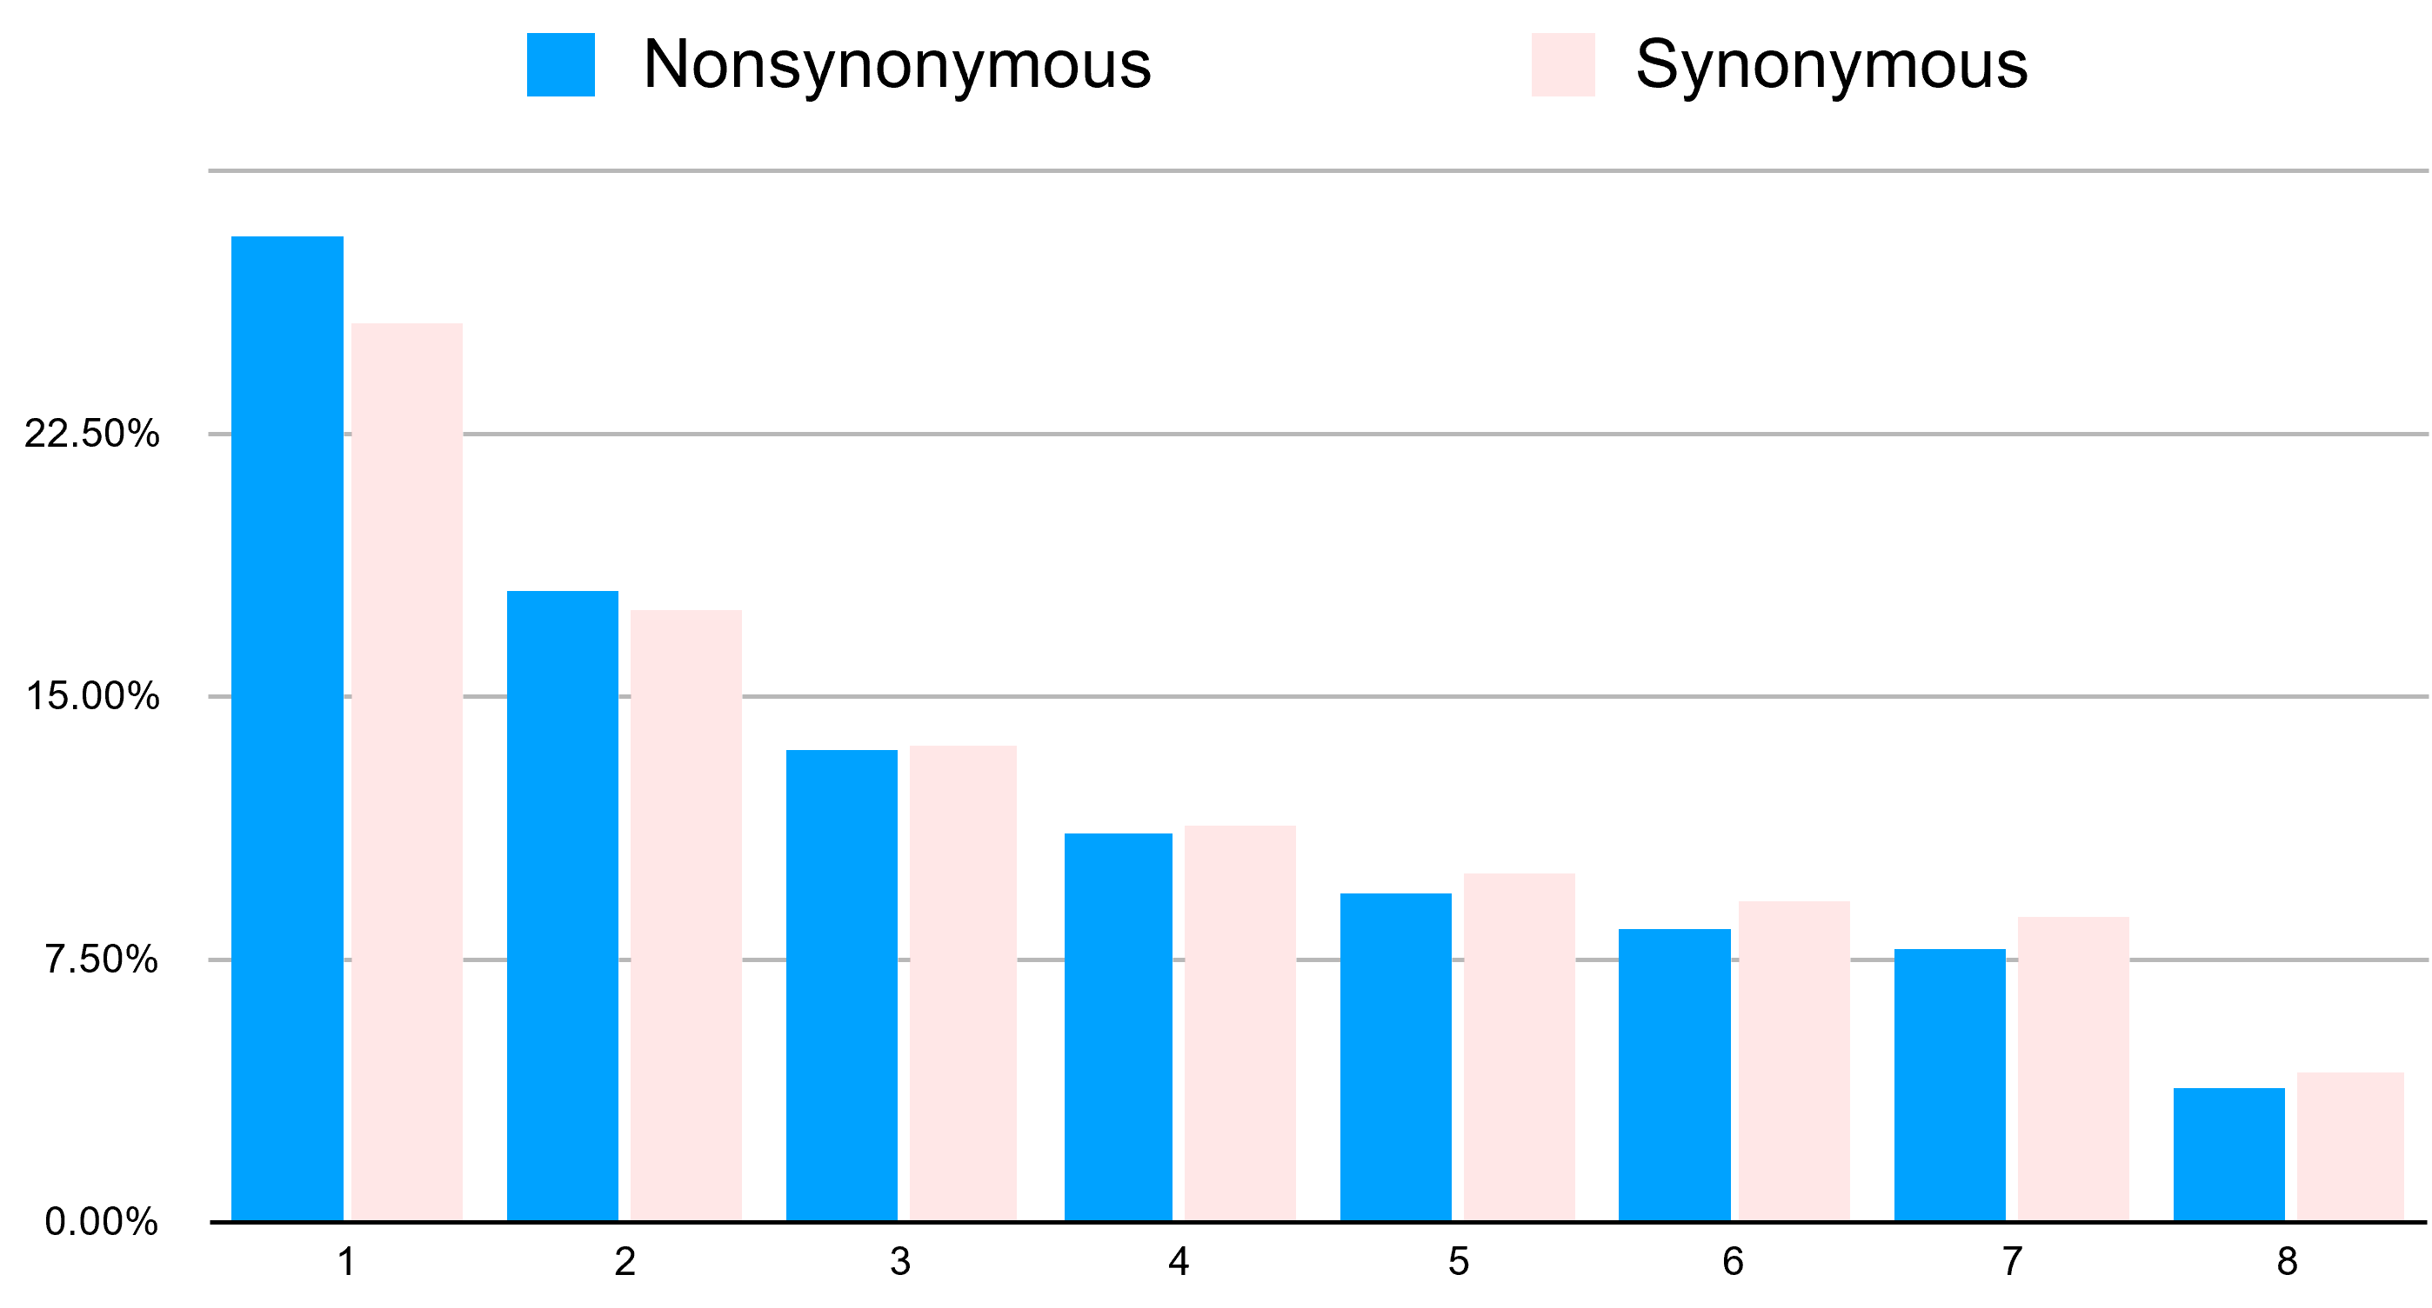
We use FitDadi to infer Selection
Notes:
However, demography is only party of the story. Next, we asked how selection might act differently on species in the human gut microbiome

Slide 43
We use FitDadi to infer Selection
Demography Linked selection Selection pressure
Demography
Linked selection
Notes:
We used a statistical inference package known as FitDadi (like Dadi, but fit) to infer selection. The major difference between Dadi and FitDadi is that FitDadi instead leverages the blue nonsynonymous site frequency spectrum to infer selection, conditional on demography, by treating the putatively neutral red synonymous sites as a reference for neutral evolution.
Include a short transition about how there’s some work (Bernard Kim 2017 Genetics) looking at the DFE in some Eukaryotes, but here we’re investigating

Slide 44
We use FitDadi to infer Selection
Demography Linked selection Selection pressure
Demography
Linked selection
Notes:
We used a statistical inference package known as FitDadi (like Dadi, but fit) to infer selection. The major difference between Dadi and FitDadi is that FitDadi instead leverages the blue nonsynonymous site frequency spectrum to infer selection, conditional on demography, by treating the putatively neutral red synonymous sites as a reference for neutral evolution.
Include a short transition about how there’s some work (Bernard Kim 2017 Genetics) looking at the DFE in some Eukaryotes, but here we’re investigating

Slide 45
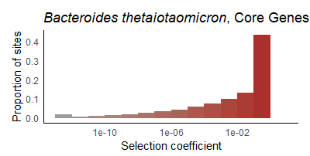
We infer the distribution of fitness effects (DFE)
Neutral
Deleterious

Slide 46
We infer the distribution of fitness effects (DFE)
Notes:
Want to see me do it again?

Slide 47
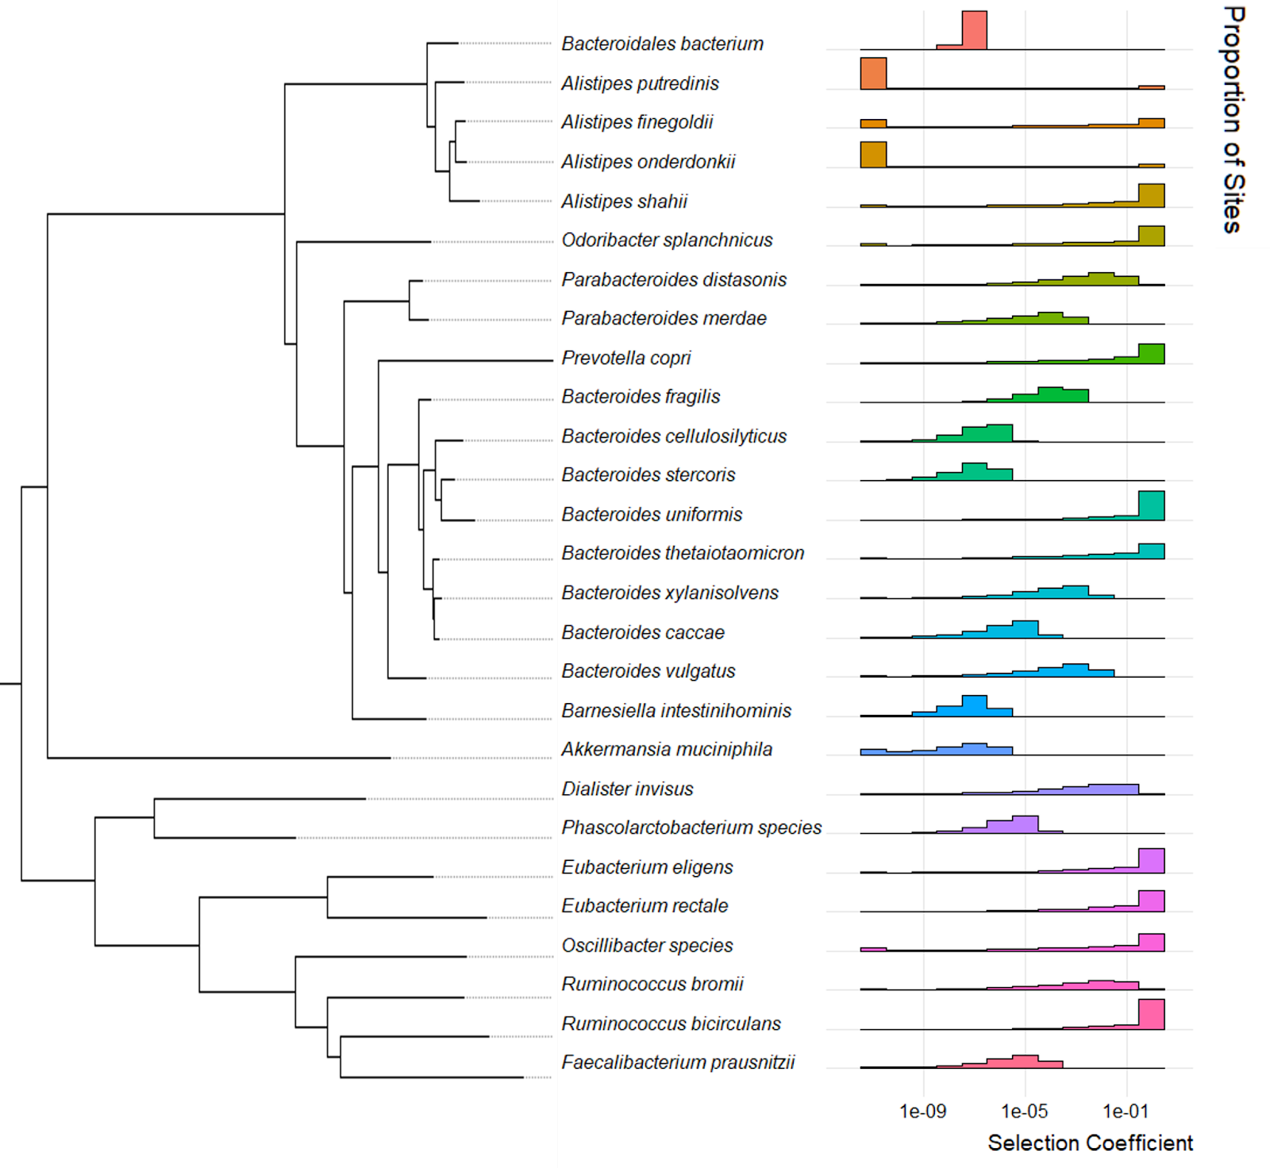
We infer varied distributions of fitness effects (DFE) across species
Notes:
Here I show a phylogenetically sorted panel of the distribution of fitness effects. Similar to the story of demography, gut commensal bacteria are found to have varying DFEs

Slide 48
We infer varied distributions of fitness effects (DFE) across species
Notes:
Explain what more deleterious selection might suggest?

Slide 49
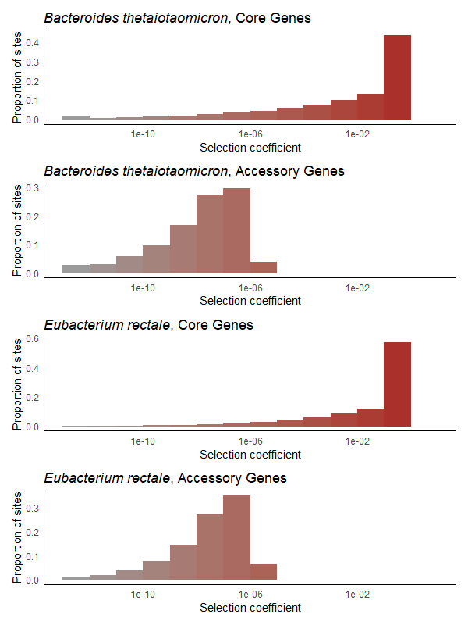
We infer varied distributions of fitness effects (DFE) within species

Slide 50
We study the Human Gut Microbiome

Slide 51
We study the Human Gut Microbiome
Core Genes
>=95% prevalence across hosts

Slide 52
We study the Human Gut Microbiome
Core Genes
>=95% prevalence across hosts
30%-70% prevalence across hosts
Accessory Genes

Slide 53
We infer varied distributions of fitness effects (DFE) within species
Notes:
Explain

Slide 54
We infer varied distributions of fitness effects (DFE) within species
Notes:
Wanna see me do it again?

Slide 55
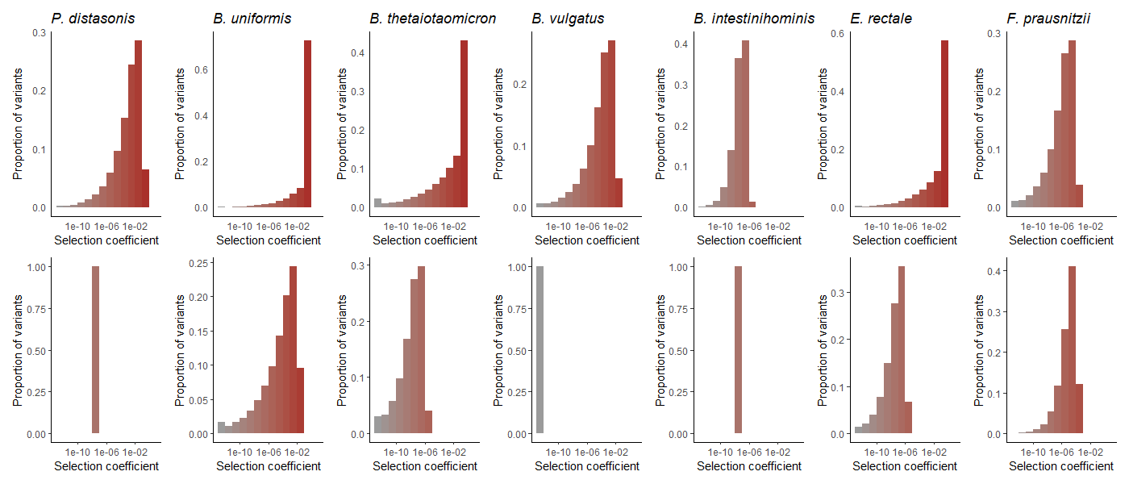

We infer varied distributions of fitness effects (DFE) within species
Core Genes
Accessory Genes
Notes:
We did! For 7 bacterial species, simultaneously. Due to limitations of data paucity we weren’t able to perform this analysis for all 27 species; however, of these 7,

Slide 56
We infer varied distributions of fitness effects (DFE) within species
Core Genes
Accessory Genes
Notes:
This difference in selection between core and accessory genes was found to be statistically significant in 5 out of 7 species when considering a null expectation incorporating effective population size, potentially suggestive of differences in the underlying population structure. Alternatively… []

Slide 57
Takeaways
Reduction of genetic diversity in North American guts
Notes:
Our work recapitulates the observed reduction of genetic diversity in North American gut bacteria

Slide 58
Takeaways
Reduction of genetic diversity in North American guts
Inference of varied demography and DFE in 27 species
Notes:
This study is the first known instance of leveraging the site-frequency spectrum to infer demography and selection in such a large number of species, which is particularly useful in elucidating the Prokaryotic branch of the tree of life

Slide 59
Takeaways
Reduction of genetic diversity in North American guts
Inference of varied demography and DFE in 27 species
Accessory genes have less deleterious DFEs than core genes
Notes:
Even within species, we found that different parts of the genome are subject to different levels of selection

Slide 60

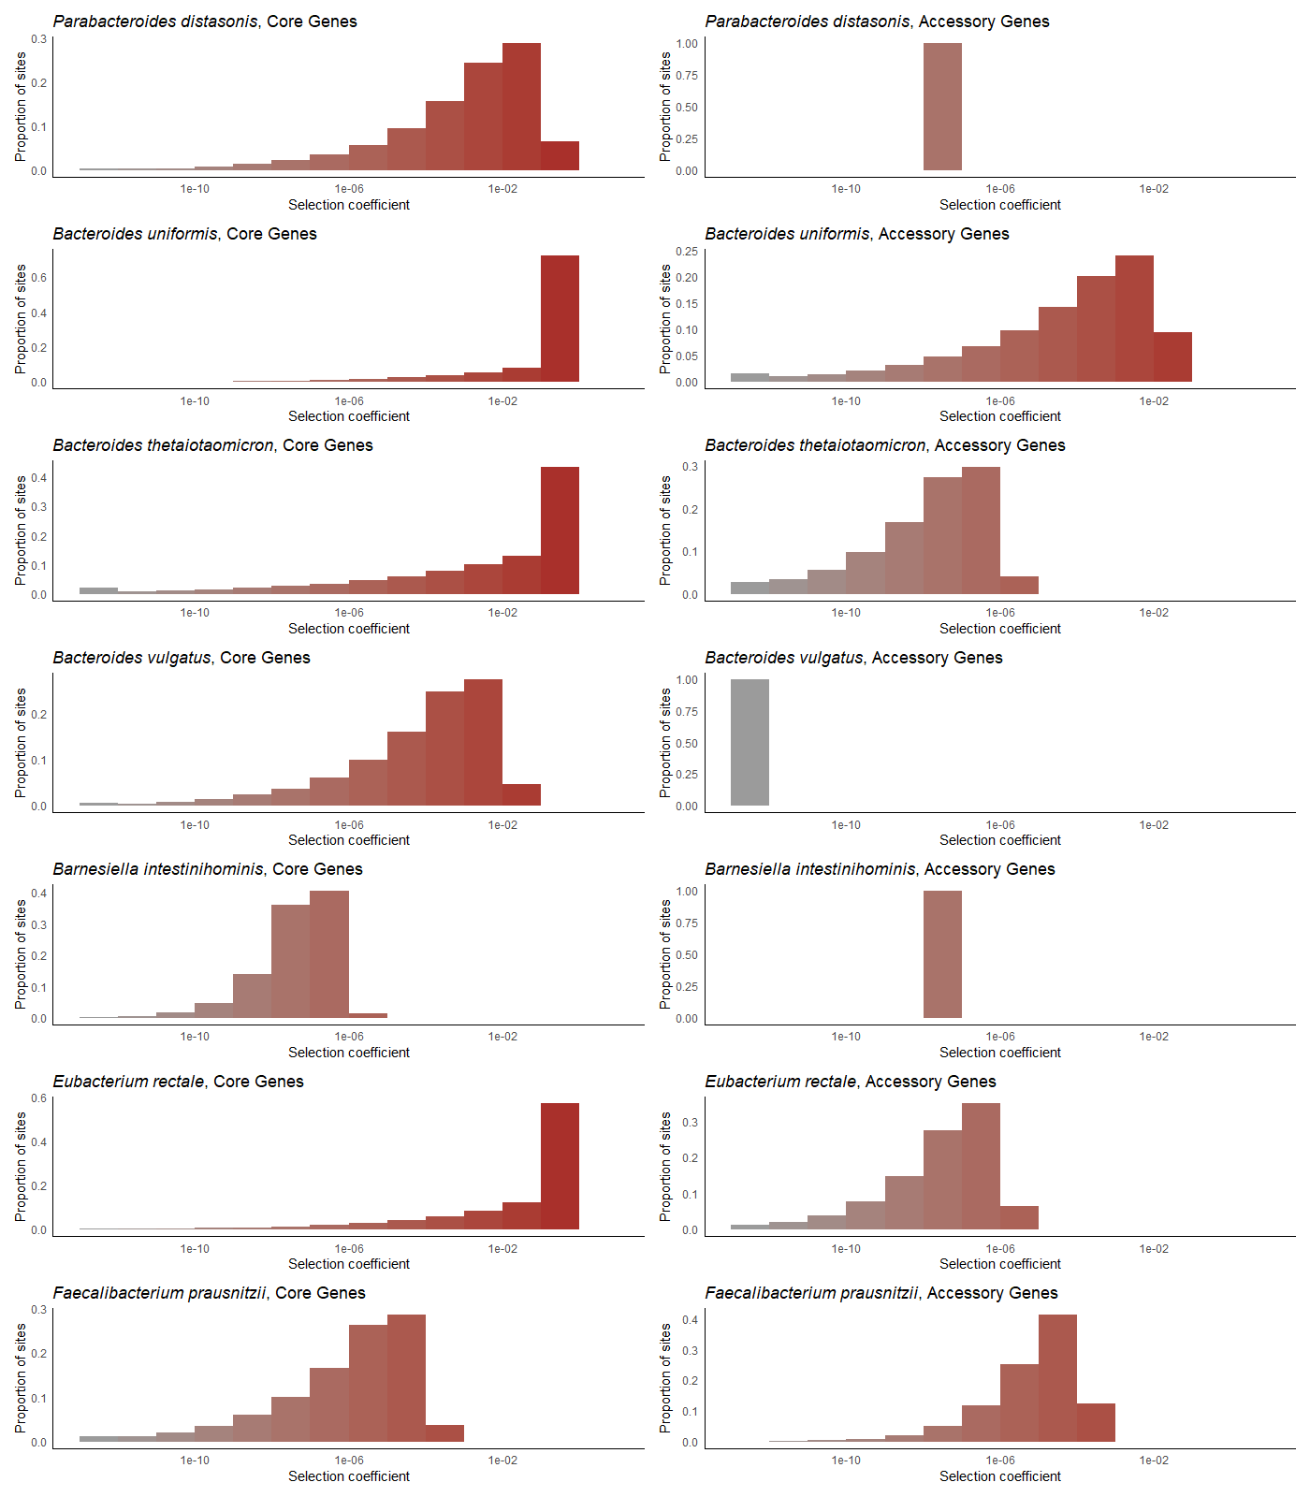
Takeaways
Reduction of genetic diversity in North American guts
Inference of varied demography and DFE in 27 species
Accessory genes have less deleterious DFEs than core genes
Future Work
Within-host DFE’s?
Notes:
And broadly, our method of inferring the DFE can be considered as taking the “average” across hosts, however, finer-scale inference on a per-host basis could reveal exciting insights into personalized medicine
[Focus on within-host vs. across-host DFE and do it well]

Slide 61


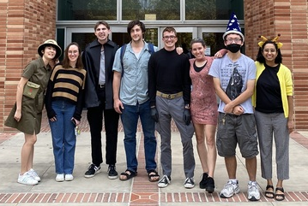






Many thanks to:
My colleagues in the Lohmueller and Garud groups for helpful discussions.
Heating
De'Longhi TRD40615E Full Room Radiant Heater (Kelvin)
Funding
NIGMS T32 5T32GM008185 (Systems in Integrative Biology)
Notes:
I’d like to acknowledge my many many wonderful colleagues for useful discussions, shown here on the left is the Lohmueller lab and shown here on the right is the Garud Lab.
I’d also like to thank our heater, especially in the Winter, we named it Kelvin
And lastly, this work was supported in part by funding from the Systems in Integrative Biology T32 training grant.

Slide 62
Many thanks to:
My colleagues in the Lohmueller and Garud groups for helpful discussions.
Heating
De'Longhi TRD40615E Full Room Radiant Heater (Kelvin)
Funding
NIGMS T32 5T32GM008185 (Systems in Integrative Biology)
Notes:
Additionally, all of my colleagues are super mega cool, but some of them are also presenting today. I’ve put a little gold star next to some of their faces – go talk to them

Slide 63

Questions?
Takeaways
Reduction of genetic diversity in North American guts
Inference of varied demography and DFE in 27 species
Accessory genes have less deleterious DFEs than core genes
Contact Information
Jonathan Mah, University of California, Los Angeles
@jonmah_compbio (maybe not this one oopsie woopsie)
@jonmah_compbio
jonmah@g.ucla.edu
Notes:
I’d like to thank you for your time and attention. Otherwise, I would be happy to take any questions if there are any, and if I don’t get to you, please feel free to reach me via this contact information!

Slide 64
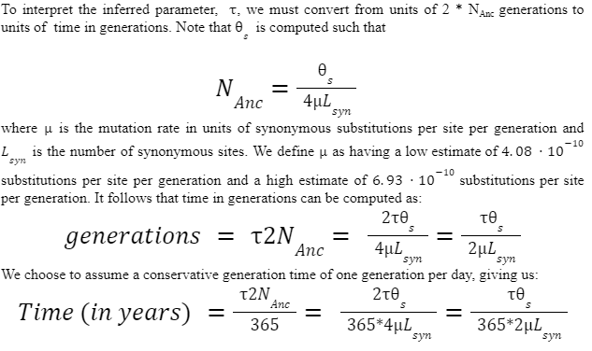
That’s a great question!

Slide 65
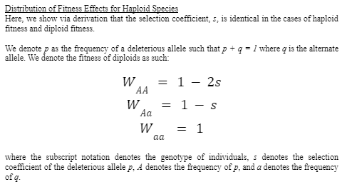
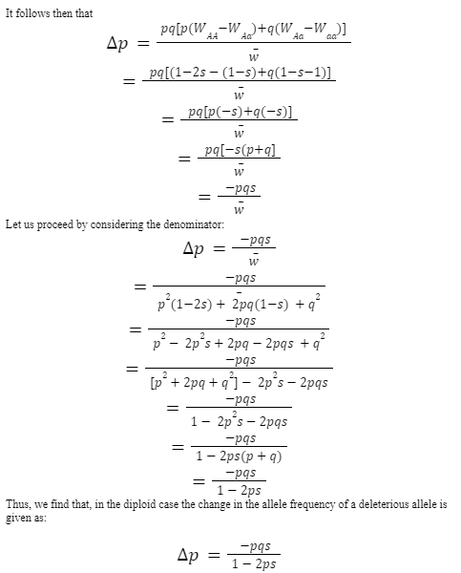
That’s a great question!

Slide 66
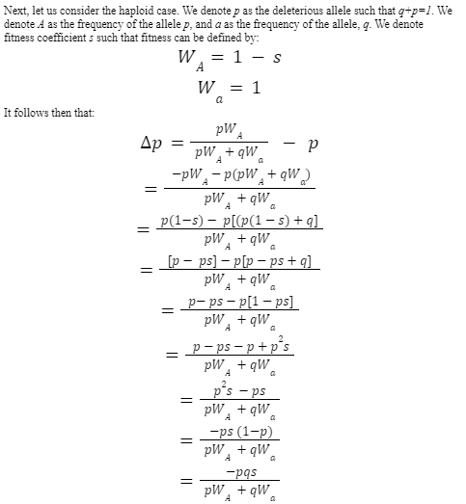
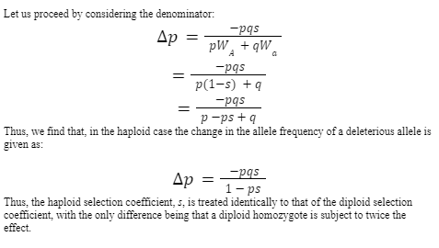
That’s a great question!

Slide 67
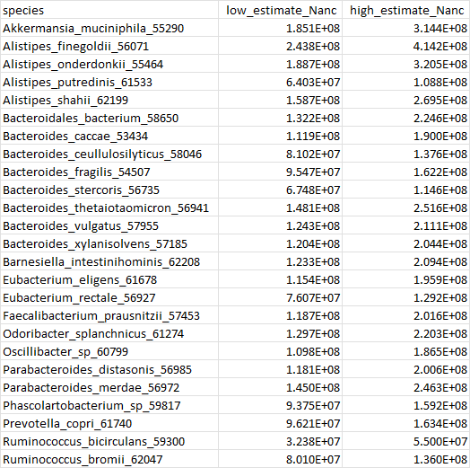
That’s a great question!

Slide 68
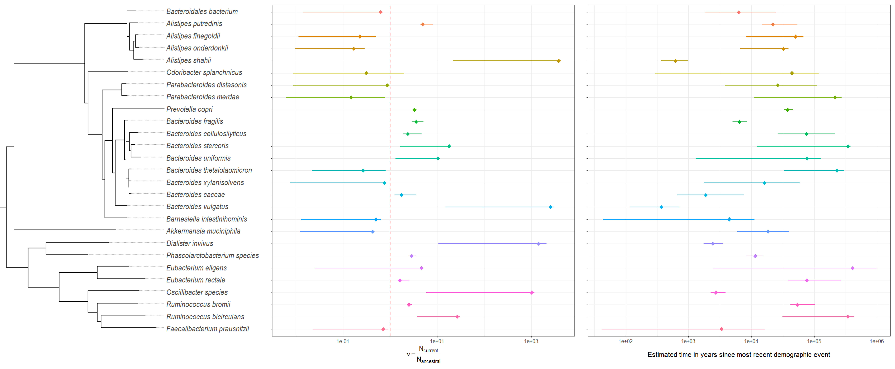
That’s a great question!
Notes:
Confidence intervals by species

Slide 69
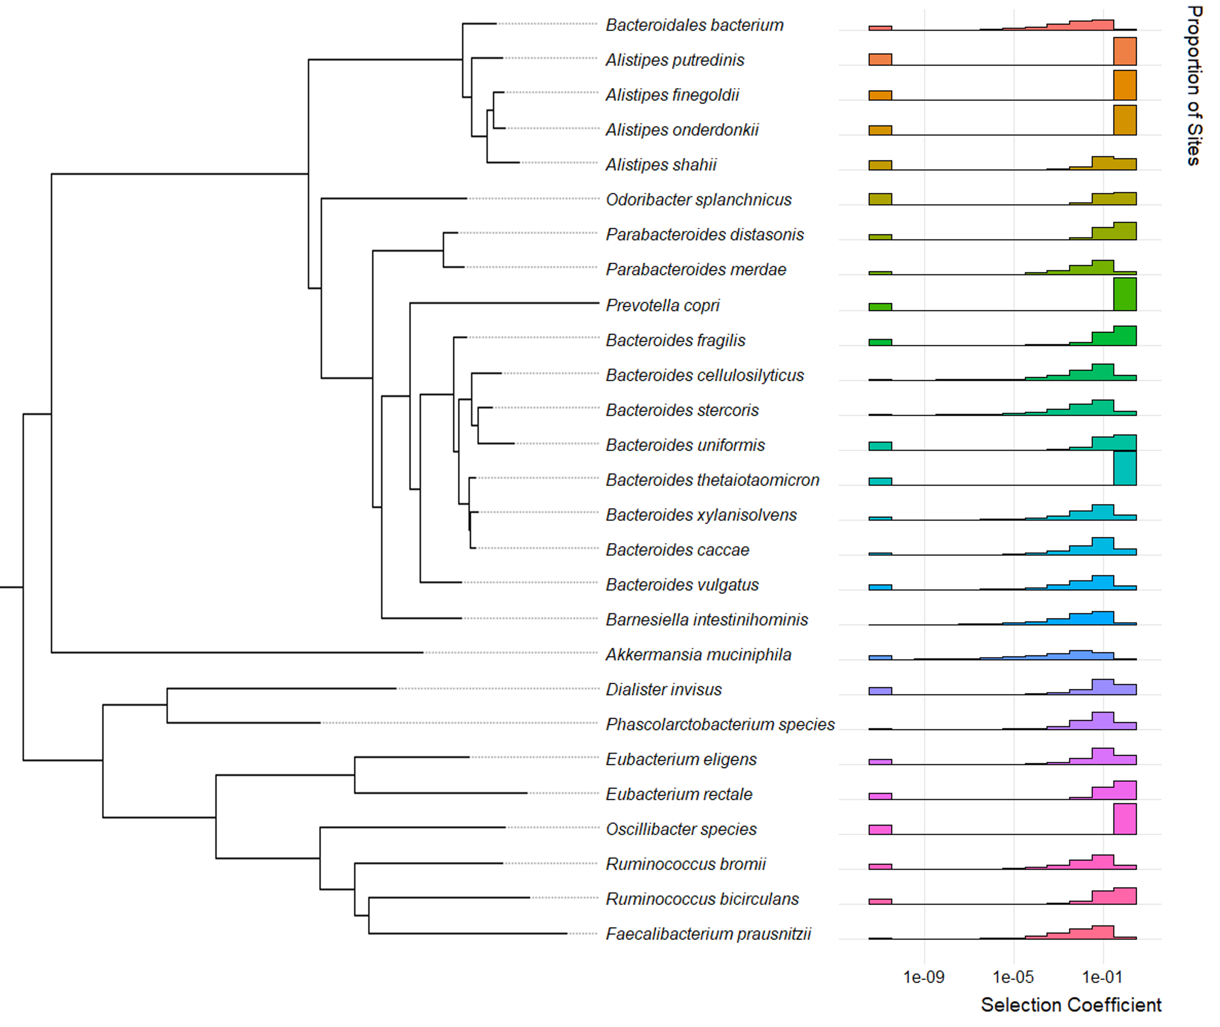
That’s a great question!
Notes:
Neutral+gamma DFE

Slide 70
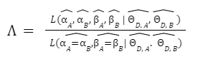
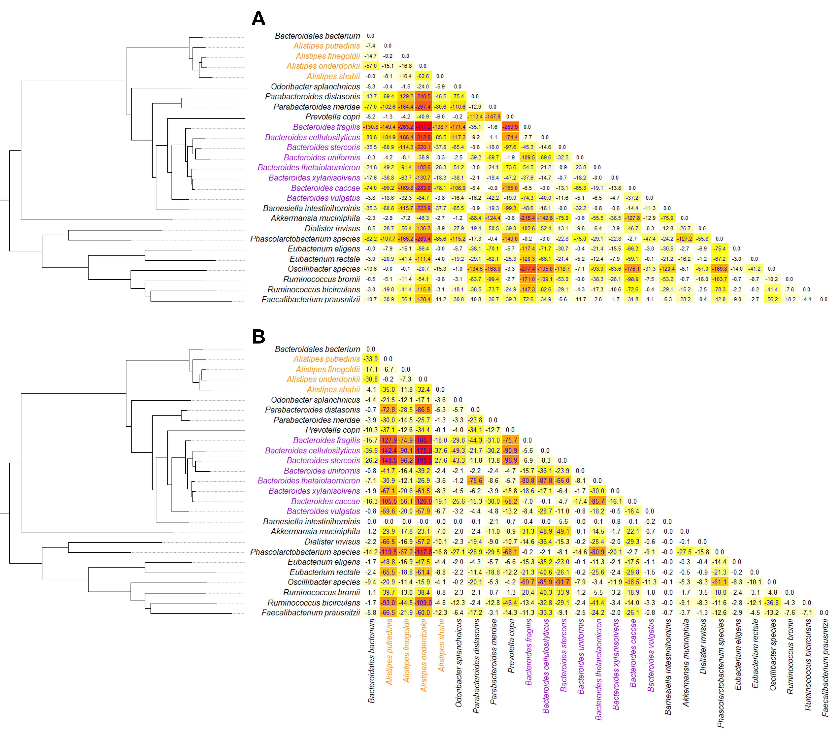
That’s a great question!
Selection coefficient, s
Population-scaled selection coefficient,
2N_{Anc}*s
Notes:
LRT across species

Slide 71
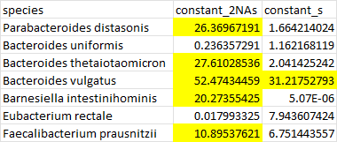
That’s a great question!
For 7 comparisons, the Bonferroni-corrected critical value is approximately 9.88
Notes:
LRT within species

Slide 72
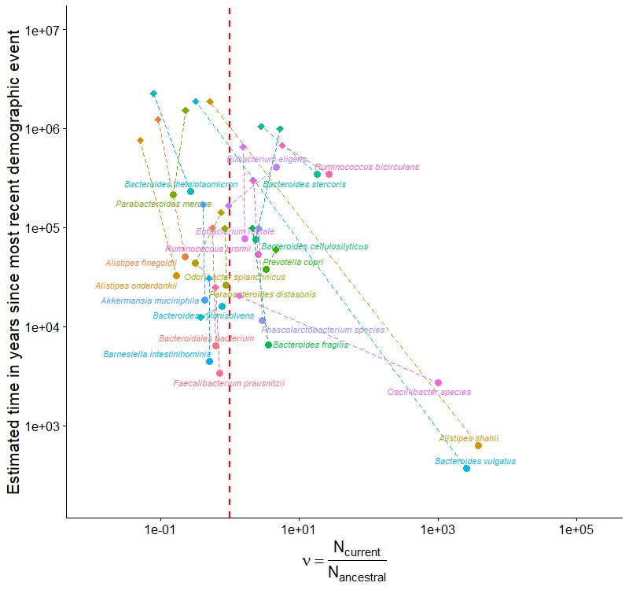
That’s a great question!
Notes:
Core genes vs. Core+Acc genes

Slide 73
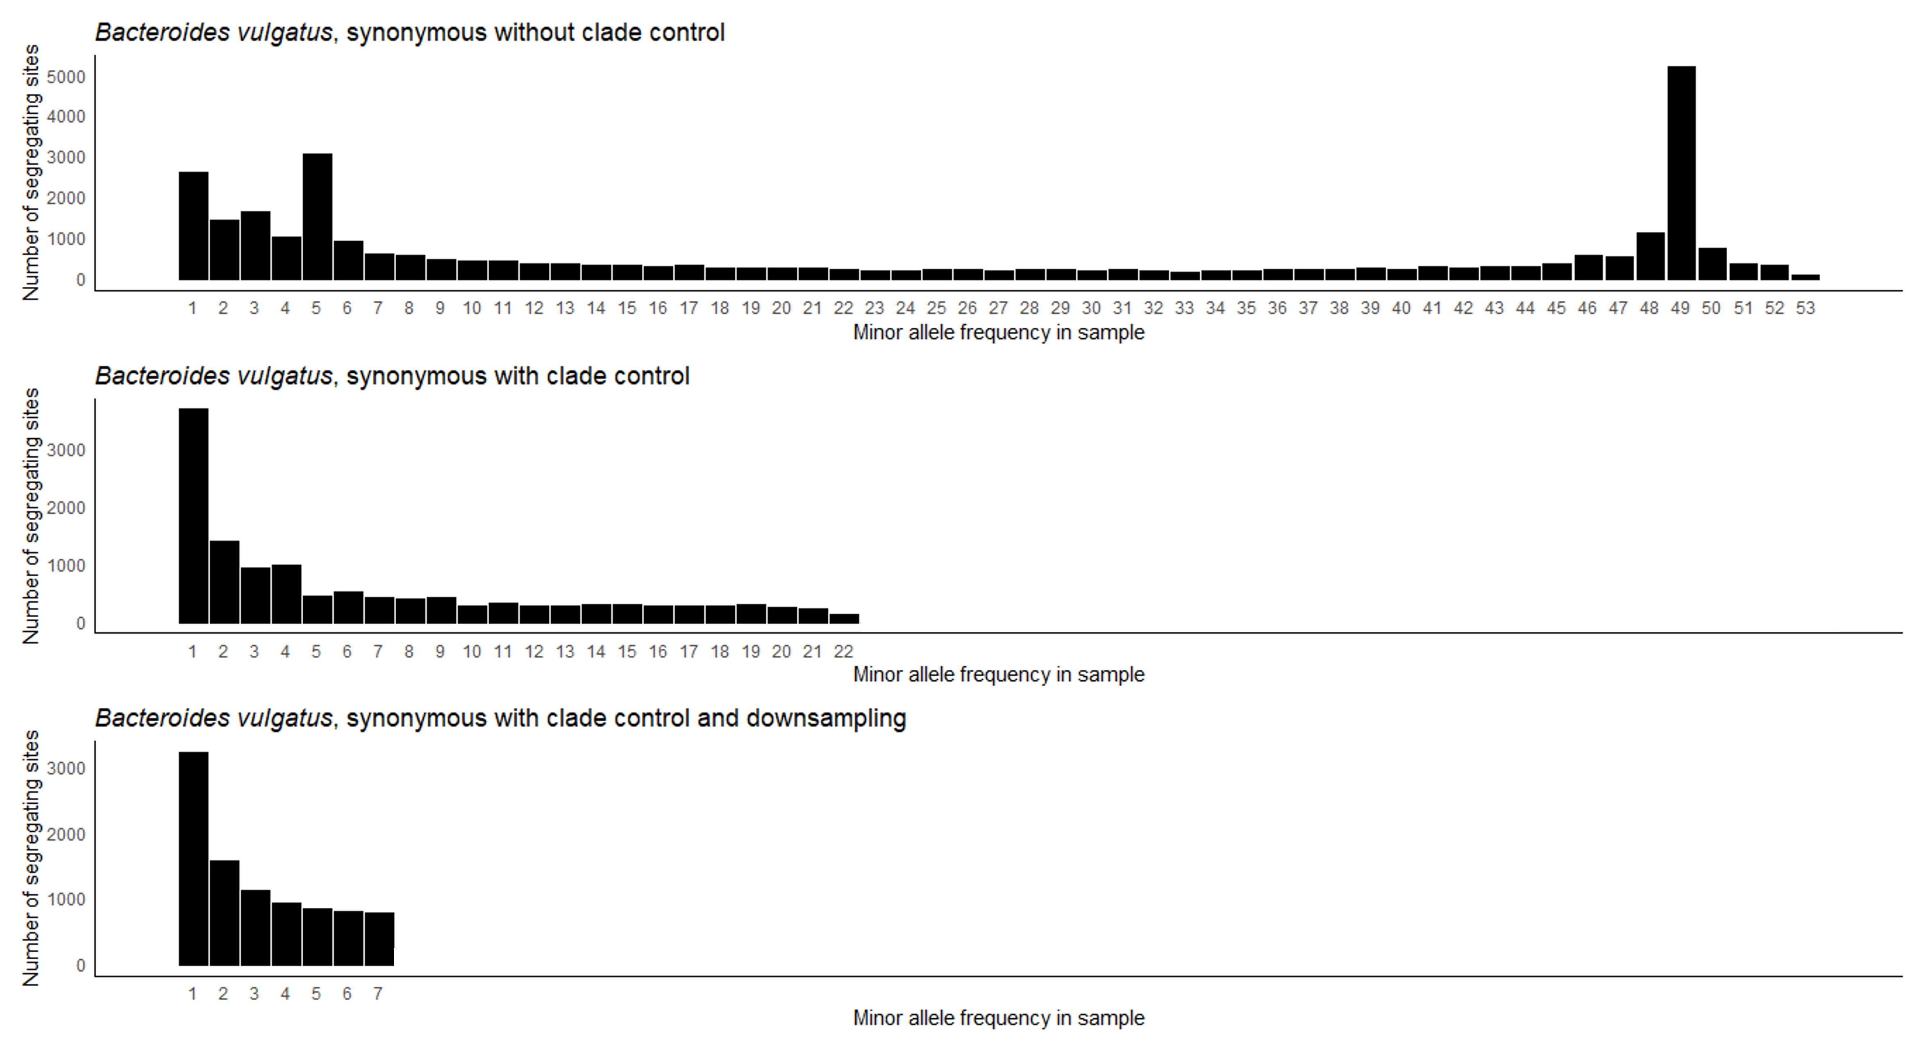
That’s a great question!

Slide 74
That’s a great question!

